Slide 1



Implementation of homodyne interferometers for inertial rotation sensor
The University of Washington
Jasmine Watt, M. Ross, J. van Dongen

Slide 2
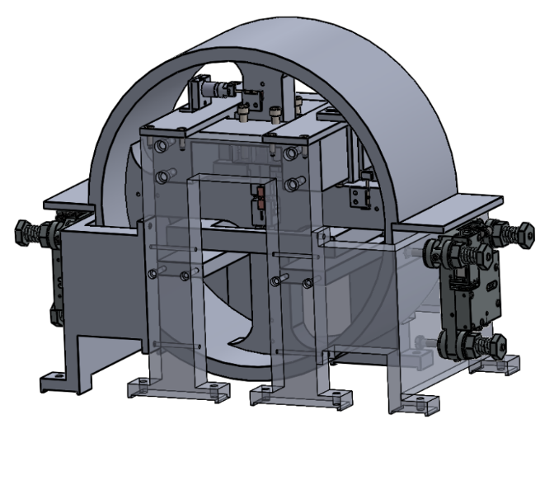
Introduction
The inertial rotation sensor in the LIGO seismic isolation platforms
Homodyne Quadrature Interferometer (HoQI)
Prototype : the tabletop HoQI
Notes:
New rotation sensor

Slide 3





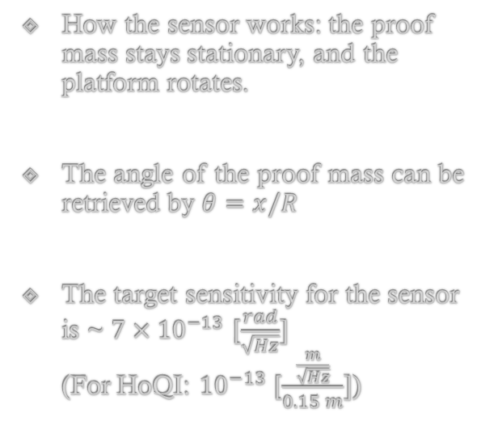

The inertial rotation sensor
suspended, at rest
How the sensor works: the proof mass stays stationary, and the platform rotates.
The angle of the proof mass can be retrieved by $θ=x/R$
The target sensitivity for the sensor is ~ $7×{10}^{−13}$ [$\frac{rad}{\sqrt{Hz}}]$ (For HoQI: ${10}^{−13}$ [$\frac{\frac{m}{\sqrt{Hz}}}{0.15 m}]$)
$$θ$$
$$R$$
$$x$$
rotates
Notes:
Mention (0.7 pico radians)
R = 0.15 m = 15 cm

Slide 4
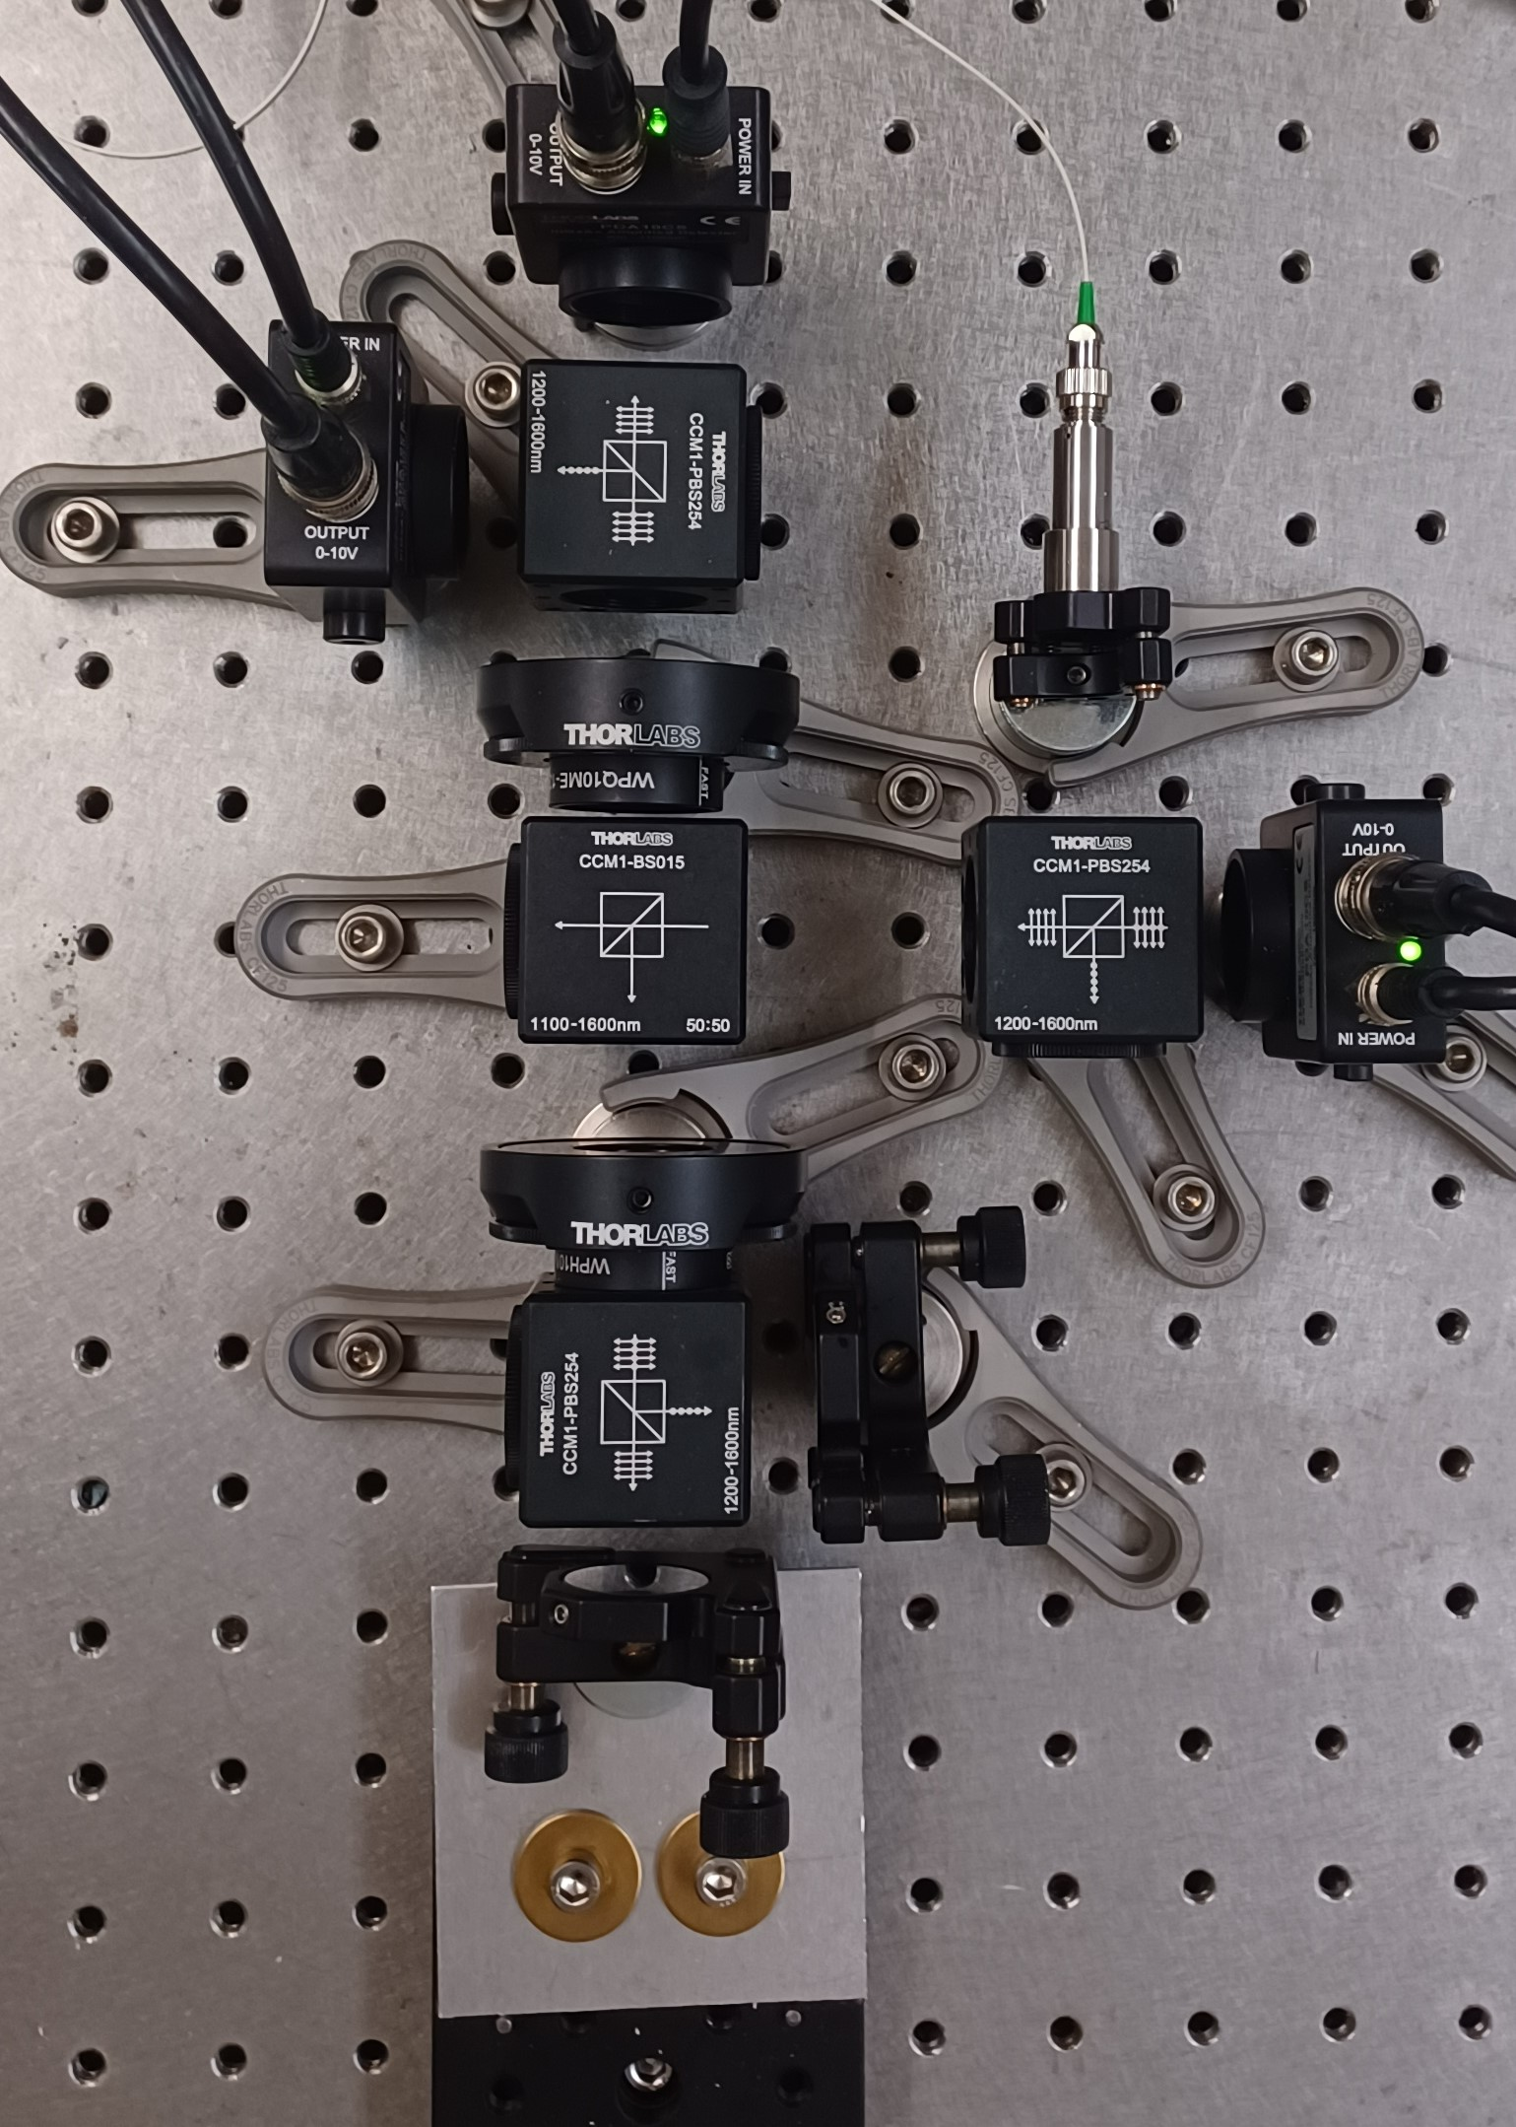
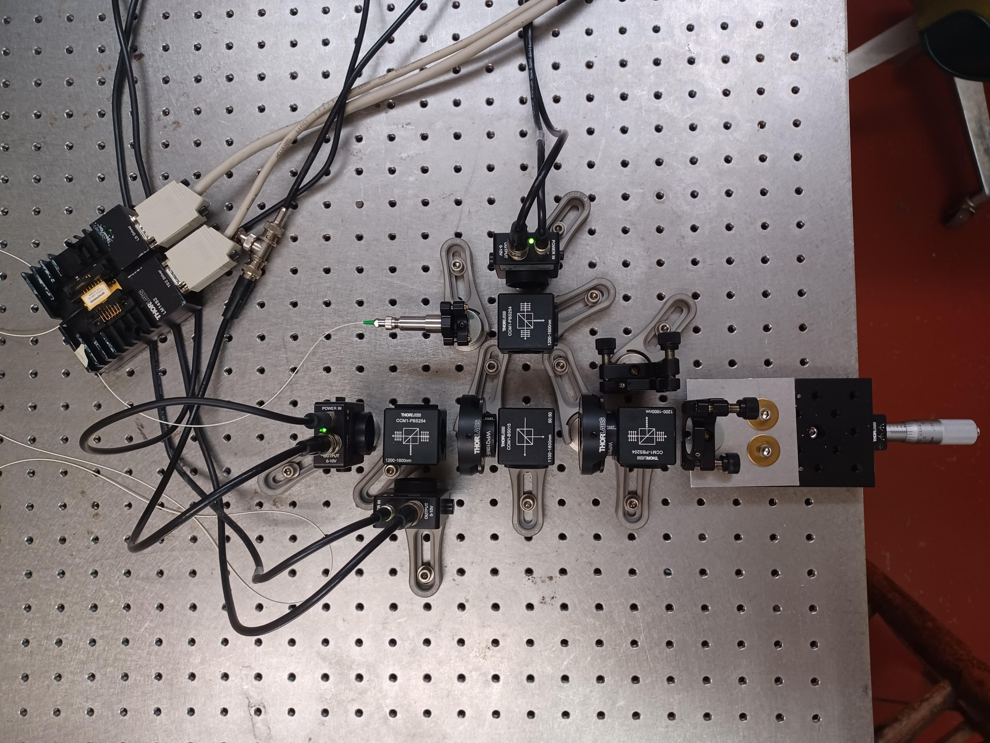
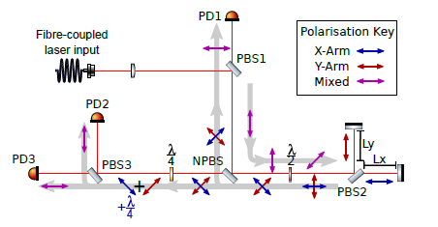
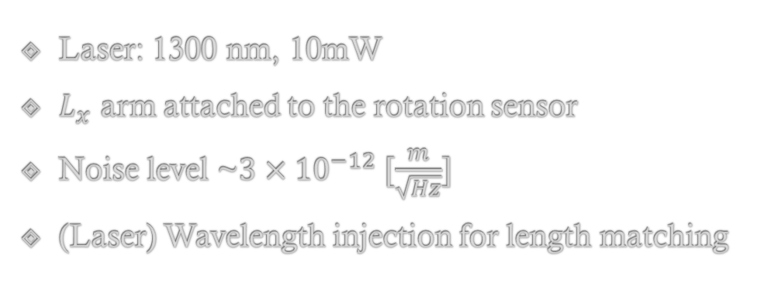

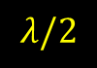
Tabletop HoQI
PD3
Laser: 1300 nm, 10mW
$L_{x}$ arm attached to the rotation sensor
Noise level ~$3×{10}^{−12} [\frac{m}{\sqrt{Hz}}]$
(Laser) Wavelength injection for length matching
PD2
$$λ/4$$
PD1
$$λ/2$$
The optical layout of HoQI. (Cooper et al., 2018)
Notes:
Michelson interferometer that uses polarization to measure multiple phases (multiple wavelength)

Slide 5
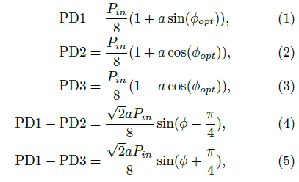
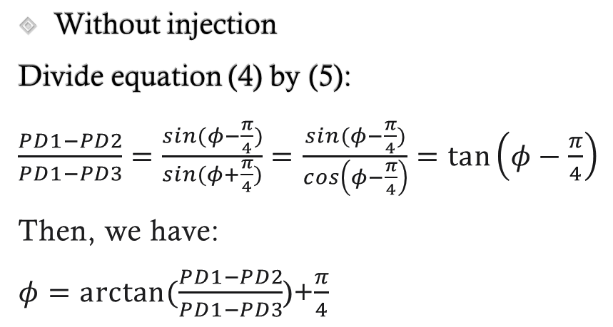

Calculations of the sensitivity
Without injection
Divide equation (4) by (5):
$\frac{PD1−PD2}{PD1−PD3}=\frac{sin⁡(φ−\frac{π}{4})}{sin(φ+\frac{π}{4})}=$ $\frac{sin⁡(φ−\frac{π}{4})}{cos\left(φ−\frac{π}{4}\right)}=\tan\left(φ−\frac{π}{4}\right)$
Then, we have:
$φ=arctan⁡(\frac{PD1−PD2}{PD1−PD3}$)+$\frac{π}{4}$
The power measured on the photodiodes. (Cooper et al., 2018)
To convert to length
$${ΔL=λ φ}_{opt}/4π$$
Notes:
a is the fringe contrast
a and power disappear -> beautiful
3 variables and 3 eqs -> we can solve
→ plot its Fourier Transform (say)

Slide 6
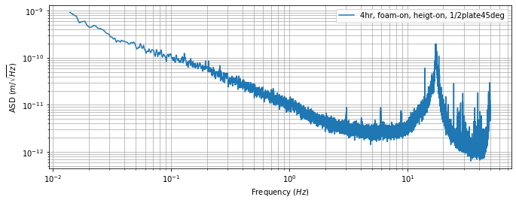
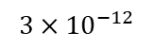
Results
table vibration(?)
ASD plot(without temperature injection)
$${3×10}^{−12}$$
Notes:
The noise recording of tabletop HoQI for 4hr data run overnight
Explain aixes: amplitude spectral density
The low frequency noise due to air flow and temperature change

Slide 7
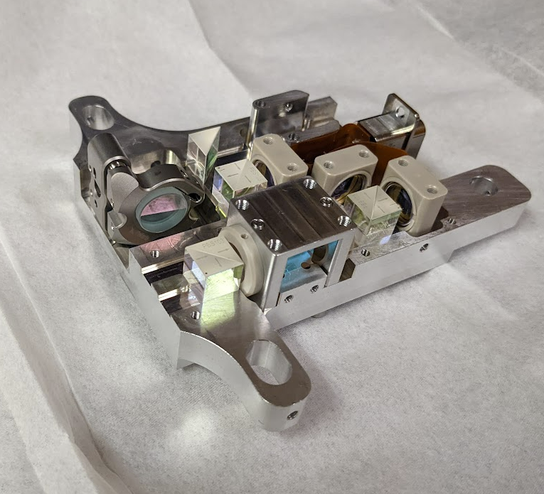
HoQI
Laser
Light beam
Function under vacuum
Compacted design
Installation and data collection
Notes:
The size of HoQI is 3 inches can fit in your hand
Briefly indicate components

Slide 8
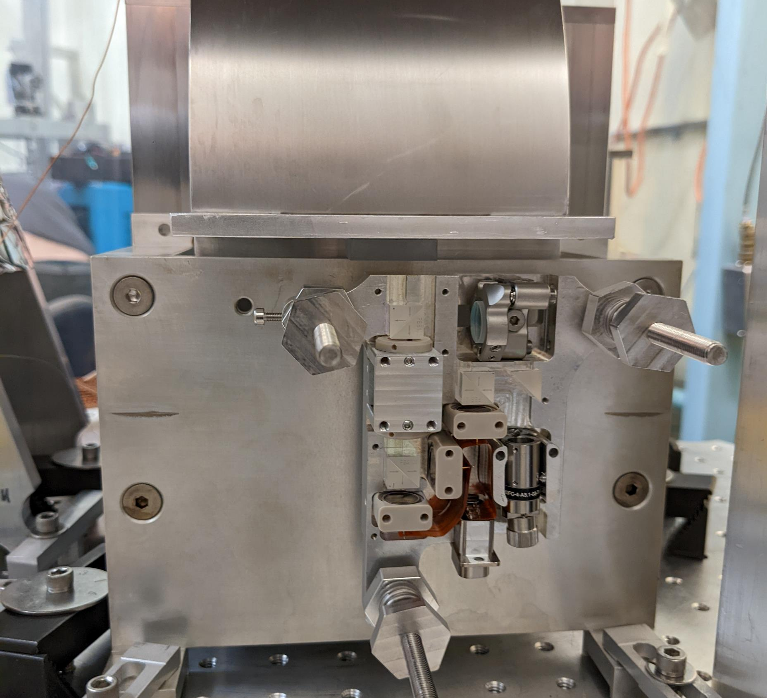
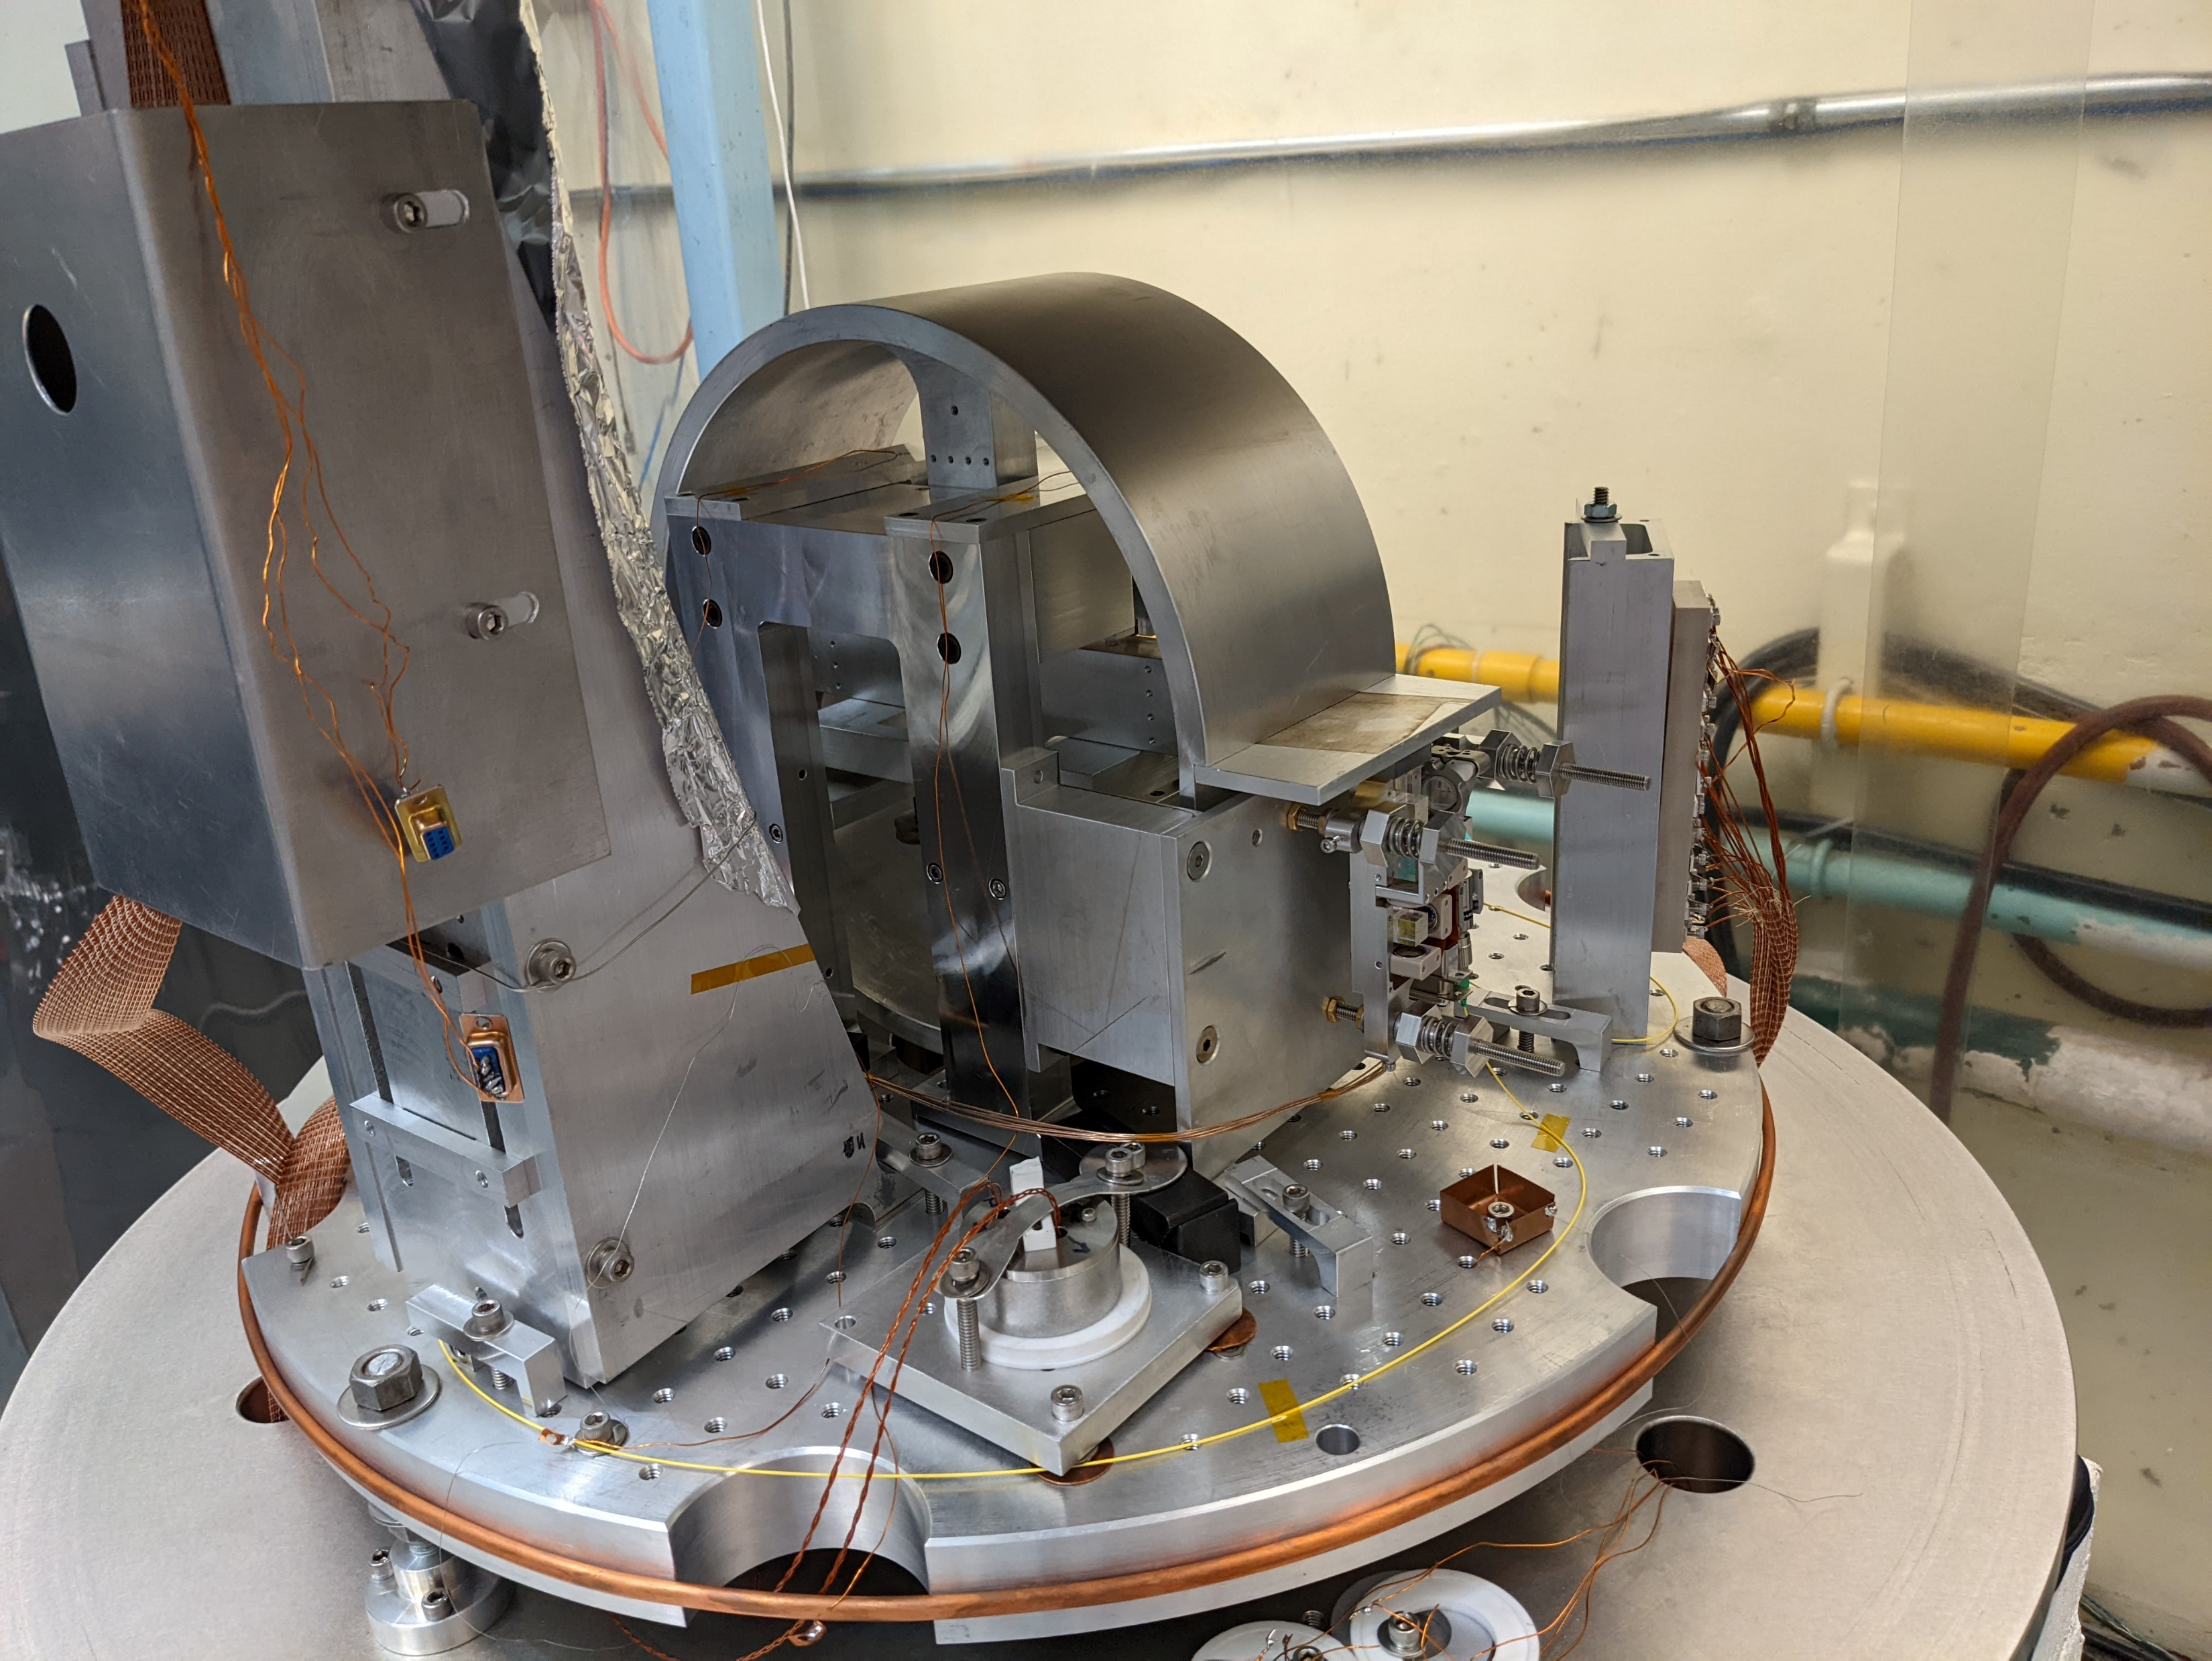

HoQI installation overview.
(Picture by Michael Ross, 2022)
$$x$$
HoQI installation zoom-in.
(Picture by Michael Ross, 2022)

Slide 9
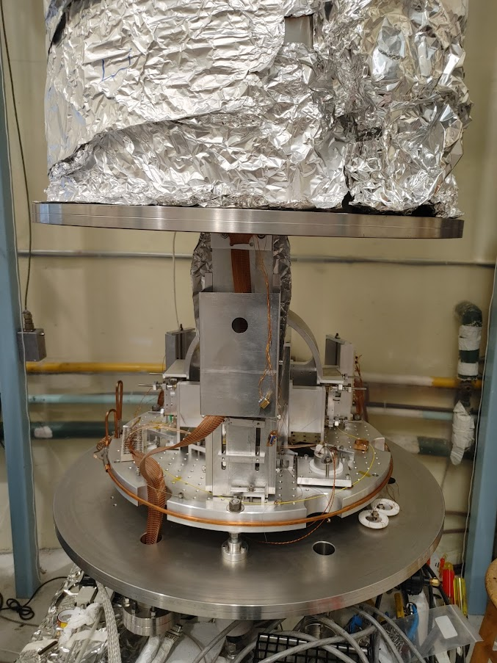
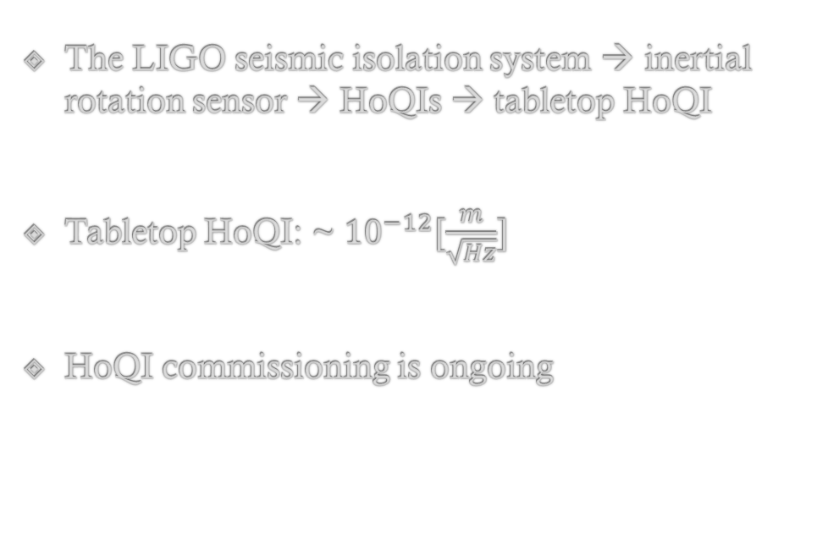
Conclusion
The LIGO seismic isolation system → inertial rotation sensor → HoQIs → tabletop HoQI
Tabletop HoQI: ~ ${10}^{−12}[\frac{m}{\sqrt{Hz}}]$
HoQI commissioning is ongoing

Slide 10
Thank you for attendance!
References:
Cooper, S. J., Green, A. C., Collins, C., Hoyland, D., Speake, C. C., Freise, A., & Mow-Lowry, C. M. (2018). A compact, large-range interferometer for precision measurement and inertial sensing. Classical and Quantum Gravity, 35(9), 095007. https://doi.org/10.1088/1361-6382/aab2e9
The Eöt-Wash Group at CENPA, UW.

